Slide 1





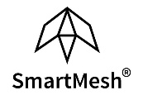
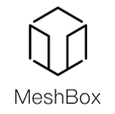
Enterprise Blockchain Developers (Intermediate)
In support of
Powered By

Slide 2
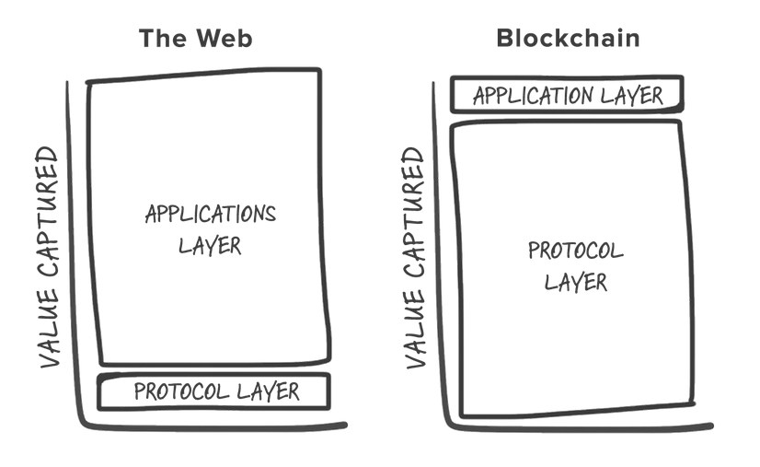
Blockchain Technology History
2016 -2018: most people think public chain is a universal solution

Slide 3
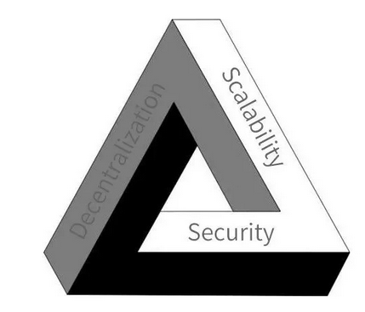
Blockchain Technology History
As results:
1. huge amount of captitals were invested into the public chain projects
2. it still cannot solve blockchain impossible triangle problem
( A blockchain system cannot simultaneously combine decentralization, scalability and security)
then looking for a tradeoff between
Decentraliztion and Scalability

Slide 4
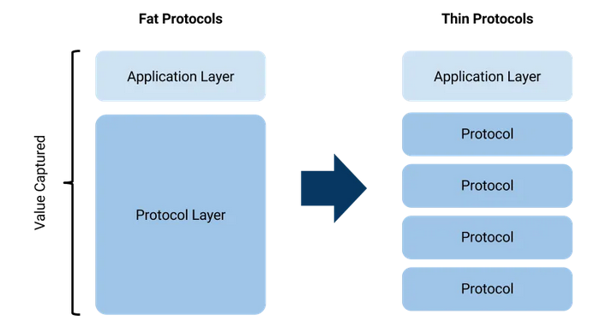
Blockchain Technology History
2019 -2020: Application Specific Chain (Ethereum: 14 tps)

Slide 5
Blockchain Technology History
1. Each chain is only designed for one business logic / business
2. Naturally, limit the number of validators
3. As a result, the chain gets more centralized
It sacrifices decentraliztion and makes the chain faster and the ecosystem more scalable
It makes commercial adption possible

Slide 6
Blockchain Technology Trends
DeFi frameworks are getting mature
Governance is critical
Private (permissioned) blockchains will dominate
Adaption of cross-chain solutions
Sharding

Slide 7
DeFi
Thus far, 2020 hasn’t been the best of years for many. But for decentralised finance, or DeFi, 2020 has been a period of stratospheric growth, with the total value locked in rising from under $1bn, to just under $8bn on Sep. 15, 2020
Why is Defi important? The frameworks are getting mature, after the the real assets being mapped to the chain, lots of new business models will emerge, lots of new job opportunities.
Type of Defi:
Yield Farming (e.g, Yam, APY Finance)
Insurance (e.g, Nexus Mutual)
Predictions Market (e.g., Augur and others)
Decentralized leverage trading (e.g., dYdX)
Lending Protocols (e.g., Compound, Aave, InstaDApp, and more)
Synthetic assets (e.g., UMA)
Stable Coins

Slide 8
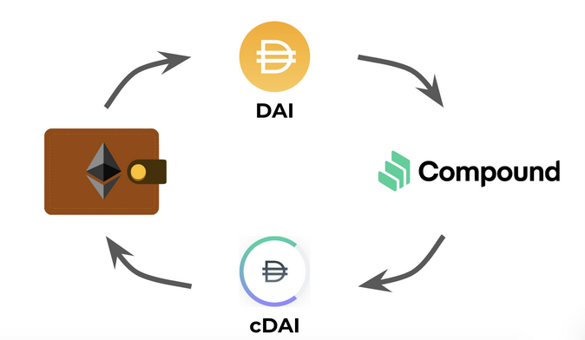
The Mechanism of Compond
The value of the collateral > the borrowed money
Increase the leverage for traders
it could drop below a certain threshold which would trigger the smart contract to close the position (also called liquidation)
ETH
DAI

Slide 9
The Mechanism of Compond
Drawback:
This cannot make a credit loan
Advantage:
It matches trustless lending and borrowing needs, makes the money more efficient
Possible Applications in the real world:
Once real assets mapped to the chain, we can use the the same framwork, to add liquidity to the illiquid assets.
Why people would like to participant
1. It gives an opportunity to token hoarders to earn interest while still having their tokens
2. It satifyies the risk takers needs in a fair environment

Slide 10
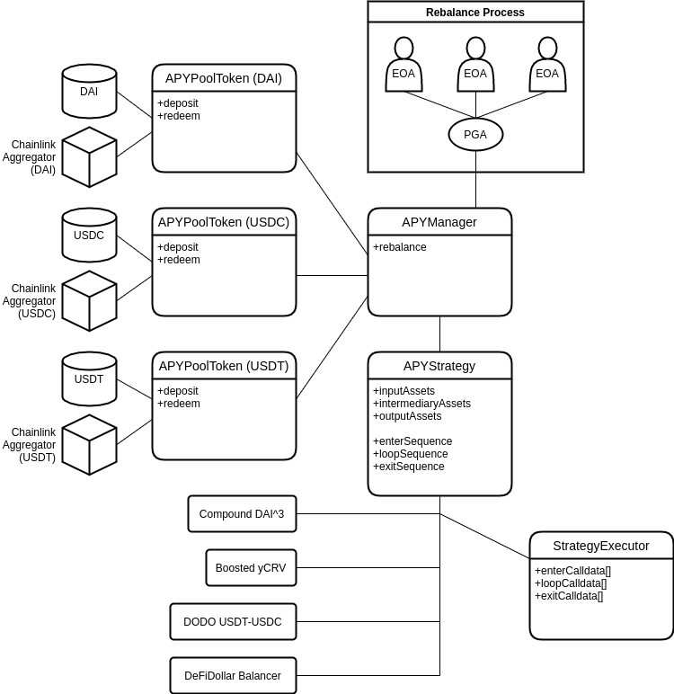
The Mechanism of APY (robot-advisor)
Stable Coins
deposit
Smart Contract
RedeemReceipt
Obtain Receipt
LP
APT
auto mine
APY
The percentage of yield

Slide 11
The Mechanism of APY (robo-advisor)
Drawback:
Increase the systematic risk
if one platform has problem, the effect would be amplified
Advantage:
1. economic of scales, saving gas fee, why?
2. aggregator, one stop shop add more liqudity to the market

Slide 12
The Mechanism of Yam(YFI, YFII)
Heat up the market as it brings the Wealth Effect, and stimulates the token hoarders
In the first place, Yam is worthless, What is the incentive to add liquidity in uniswap?
More new participants joining the game than leaving game -> price increase -> more participants until market depth poor -> price decrease -> market collapse
ETH Pool
X1 yield
MKR Pool
YAM
YAM/ETH
UNIV2/YAM
COMPPool
ETH
staking
staking
X5 yield
UNIV2 Yam
Pool

Slide 13
The Mechanism of Yam(YFI, YFII)
Drawback:
“Ponzi scheme”
Incentives:
It gives an opportunity to token hoarders to earn something that can trading for money later while still having their tokens

Slide 14
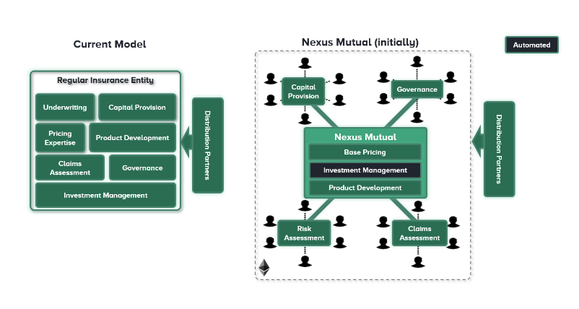
The Mechanism of Nexus Mutual (p2p Insurance)
Hard to find conterparties
Deposite
ETH
Capital
Pool
NXM
Insurance Profit

Slide 15
The Mechanism of Nexus Mutual (p2p Insurance)
Catiple provision, Governance, Risk Assessment, and Claim assessment are all decentralized.
Smart Contract Cover, crypto wallet cover, as well as more standard products, like earthquake cover, in essence, p2p insurance would be very easy to become gambling, taking their bets. why?

Slide 16
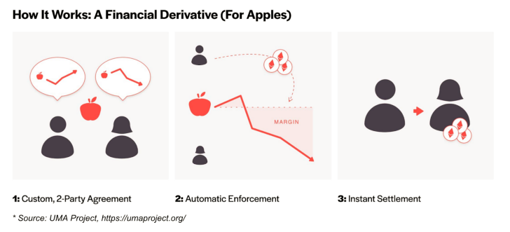
The Mechanism of UMA
this is gambling, why?
Deposit more than the synthetic asset, like Apple.
when the price hits the liquidation threshhold, the counterparty earn the difference, otherwise, the counterparty sell it out at a lower price, and the issuser earn the difference

Slide 17
Enlightment of DeFi
A healthy financial market:
4 type of players:
Business: hedage operational risk / Dividend
Investors:
Speclutators: adding liqudity
Intermediaries: issuing

Slide 18
Enlightment of DeFi
Opens up a way to attract more users
It makes all the transactions and desicions transparent
In turn:
brings more users
It solves many infomation aysmetric problems in todays financial industry
Premise: if they are well regulated and operated by the professionals within some jurisdiction

Slide 19
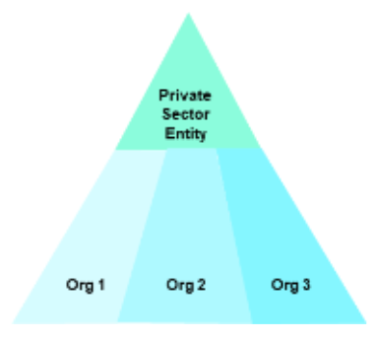
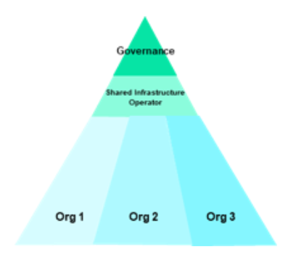
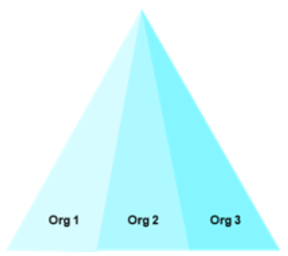
Governance
Trend one: Most of the DeFi projects have community based governance smart contracts to make decisions, why? easy to attract the user
Trend two: As the technology matures, we can see that the core challenge in the path of Blockchain’s large-scale adoption is stakeholder management and bringing competitors and unlikely collaborators together to solve shared problems.

Slide 20
Governance
Type 1: Example Centralized ICO projects
Orgs = partners:
exchanges
media
sales channel
they take tokens
and they help you promote.
Your marketing fee get dramatically decreased, once they have consensus

Slide 21
Governance
Type 2: Example Defi Project
Governance smart contract
Defi smart contract platform
orgs = individuals / partners
exchanges
media
sales channel
they take tokens
and they help you promote.
Your marketing fee get dramatically decreased, once they have consensus

Slide 22
Governance
Type 3:
Example:
Governments / Big Corpration:
coordination between departments
Hyperledger Fabric

Slide 23
Private (permissioned) blockchains
Why?
1 more inter organizational collaboration and more efficient
2 involve more potiential clients to join the community and become the “owner” of a company
markting
client loyalty
Mainstream solutions:
Hyperledge Fabric
Ethereum
R3 Corda

Slide 24
Cross-Chain Solutions
Along with the blockchain demand increase, there will be a huge need for the crosschain solutions to connect different isolated chains
Solutions:
1 Messaging Relay
2 Atomic Swap
3 Centralized Gateway

Slide 25
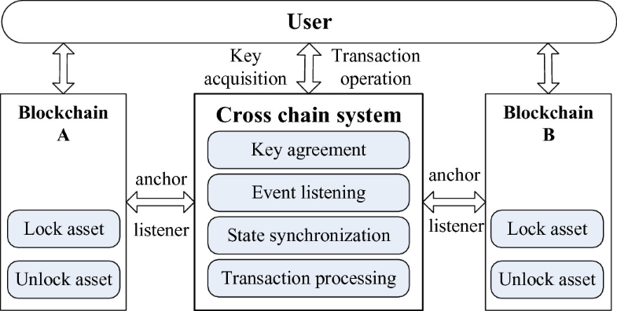
Cross-Chain Solutions

Slide 26
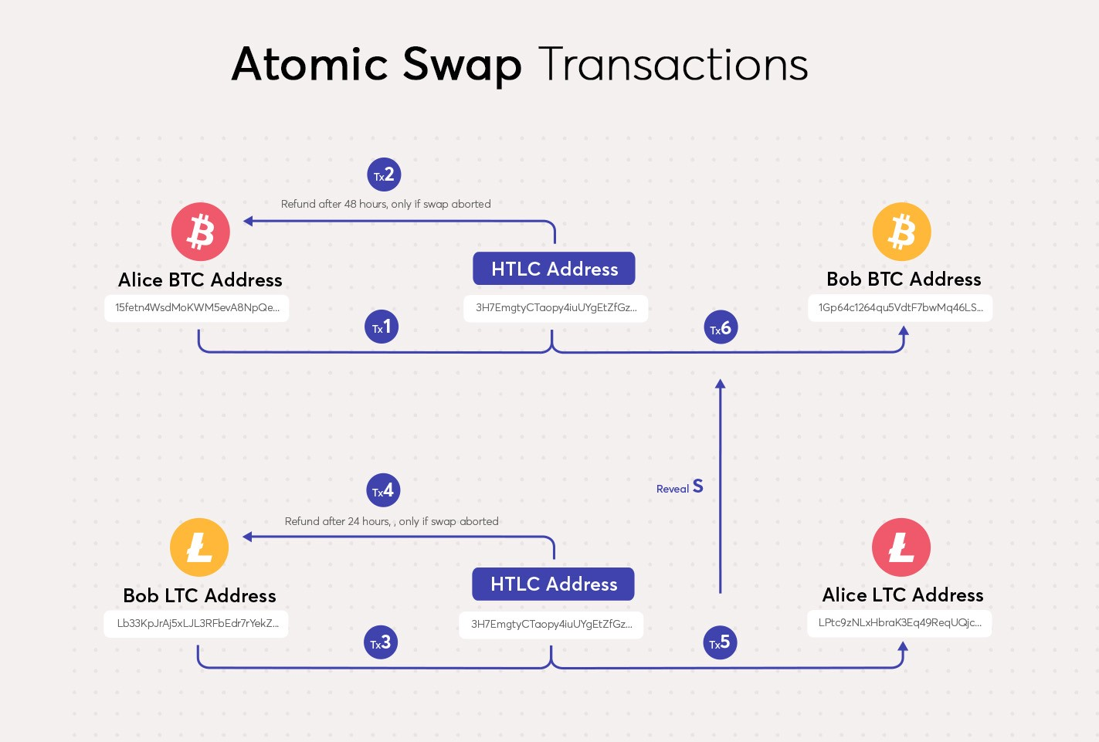
Cross-Chain Solutions

Slide 27
Cross-Chain Solutions
G
G
Gateway
A
A

Slide 28
Cross-Chain Solutions
Difference:
Messaging Relay: the token is a proxy
Atomic : the token is authentic
Gateway: centralized program

Slide 29
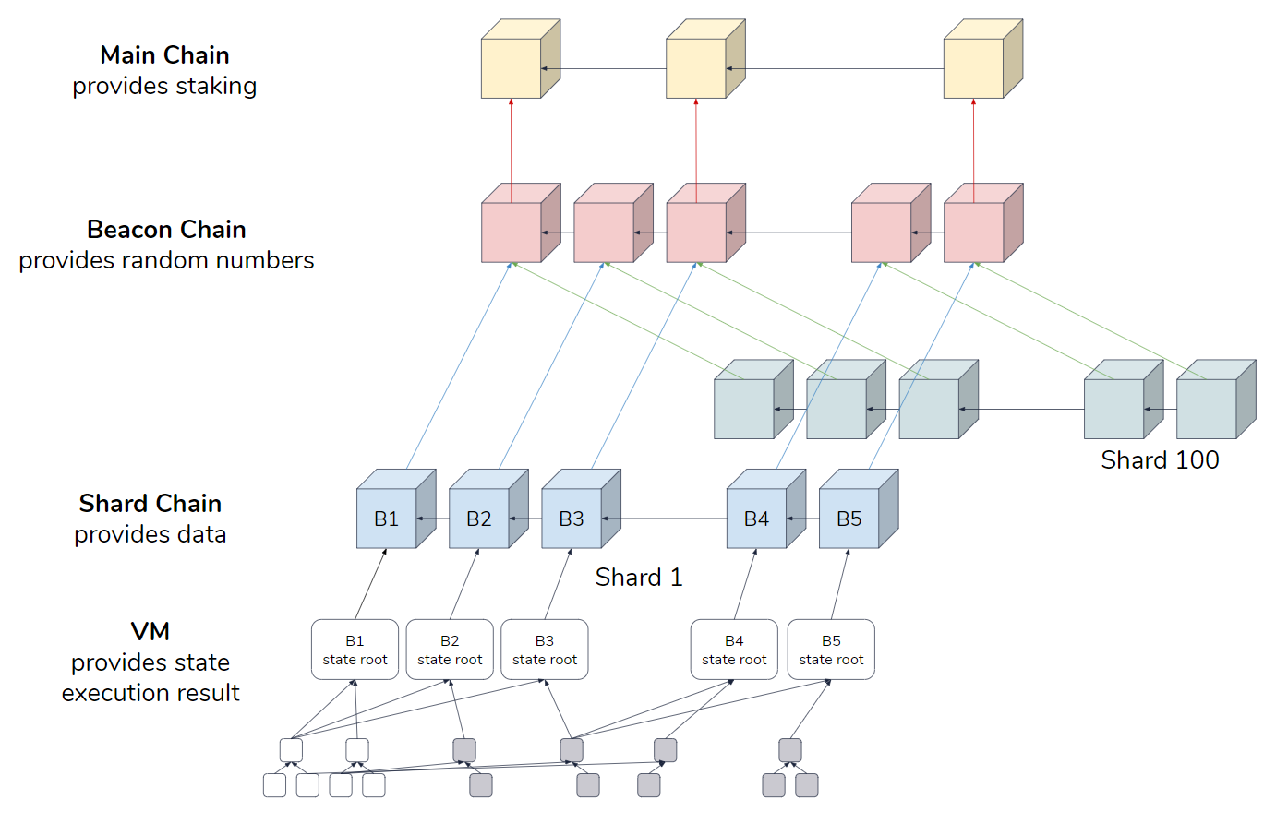
Sharding

